Slide 1
Banning Lewis Ranch Metropolitan District No. 4 Annual Meeting
November 27, 2023

Slide 2
Agenda
Public
Infrastructure
Unaudited Financials
Outstanding Debt

Slide 3
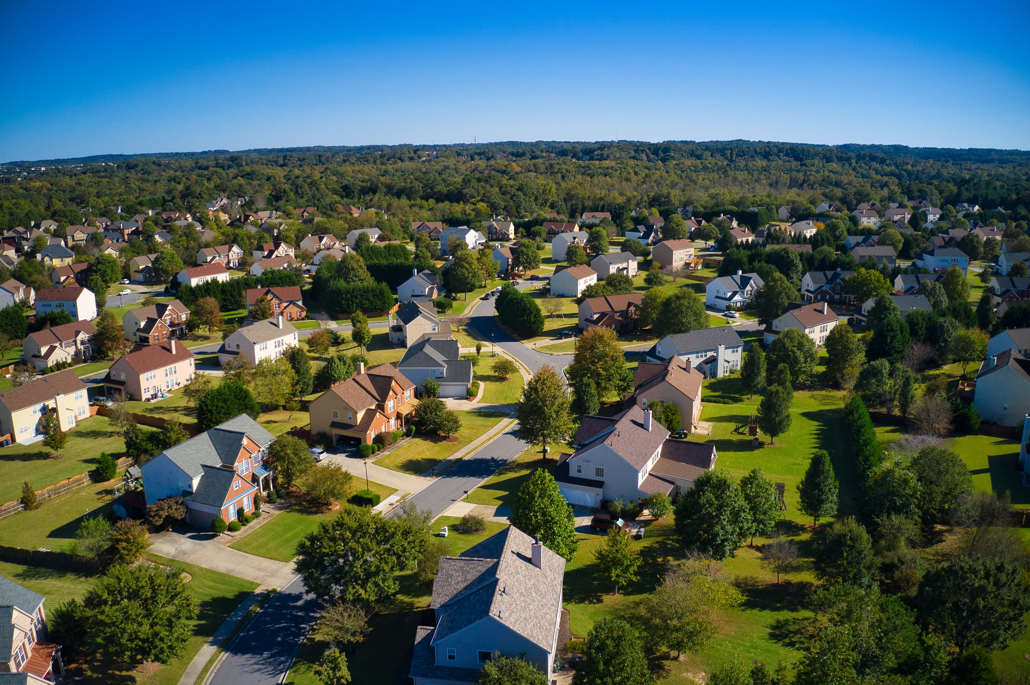
Outstanding Debt

Slide 4
Outstanding Debt - Bonds
Series 2018A Limited Tax General Obligation Bonds
$12,520,000 Issuance
5.750% Interest rate
Maturity: December 1, 2048
Payments: Semi-annually on June 1 and December 1
Proceeds used for District public infrastructure
Optional redemption with premium December 1, 2023
Optional redemption without premium December 1, 2026
Required Mill Levy to fund annual payments not to exceed 30.000 mills
Series 2018B Limited Tax General Obligation Bonds
$2,063,000 Issuance
8.000% Interest rate
Maturity: December 15, 2048
Payments: Annually on December 15 once Max Surplus Account reaches $1,252,000
As of December 31, 2022, Surplus in Trustee accounts totals $386,517
Proceeds used for District public infrastructure
Optional redemption with premium December 15, 2023
Optional redemption without premium December 15, 2026
Required Mill Levy to fund annual payments not to exceed 30.000 mills

Slide 5
Outstanding Debt - Bonds
Series 2018C Limited Tax General Obligation Bonds
$4,134,000 Issuance
Interest rate 8.000%
Maturity: December 1, 2051
Payments: Annually on December 15 once Series 2018B bonds have been paid off
Proceeds used for District public infrastructure
Optional redemption with premium December 15, 2023
Optional redemption without premium December 15, 2026
Required Mill Levy to fund annual payments not to exceed 30.000 mills

Slide 6
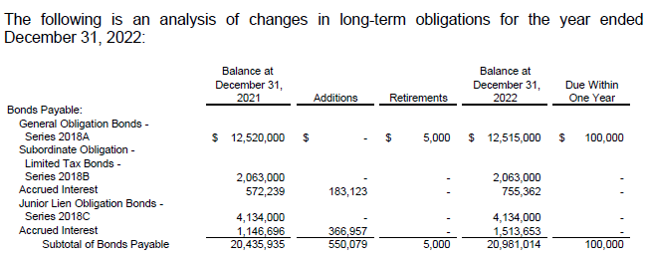
Outstanding Debt – Long-Term Liability Table

Slide 7
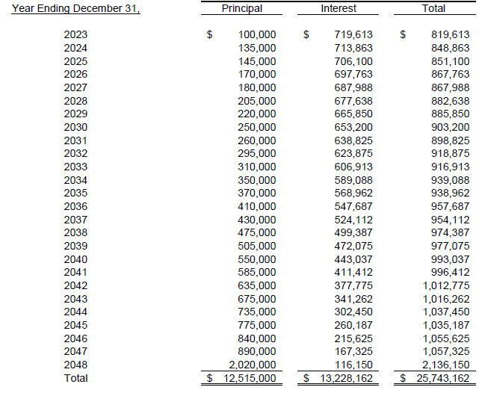
Series 2018A Amortization Schedule

Slide 8
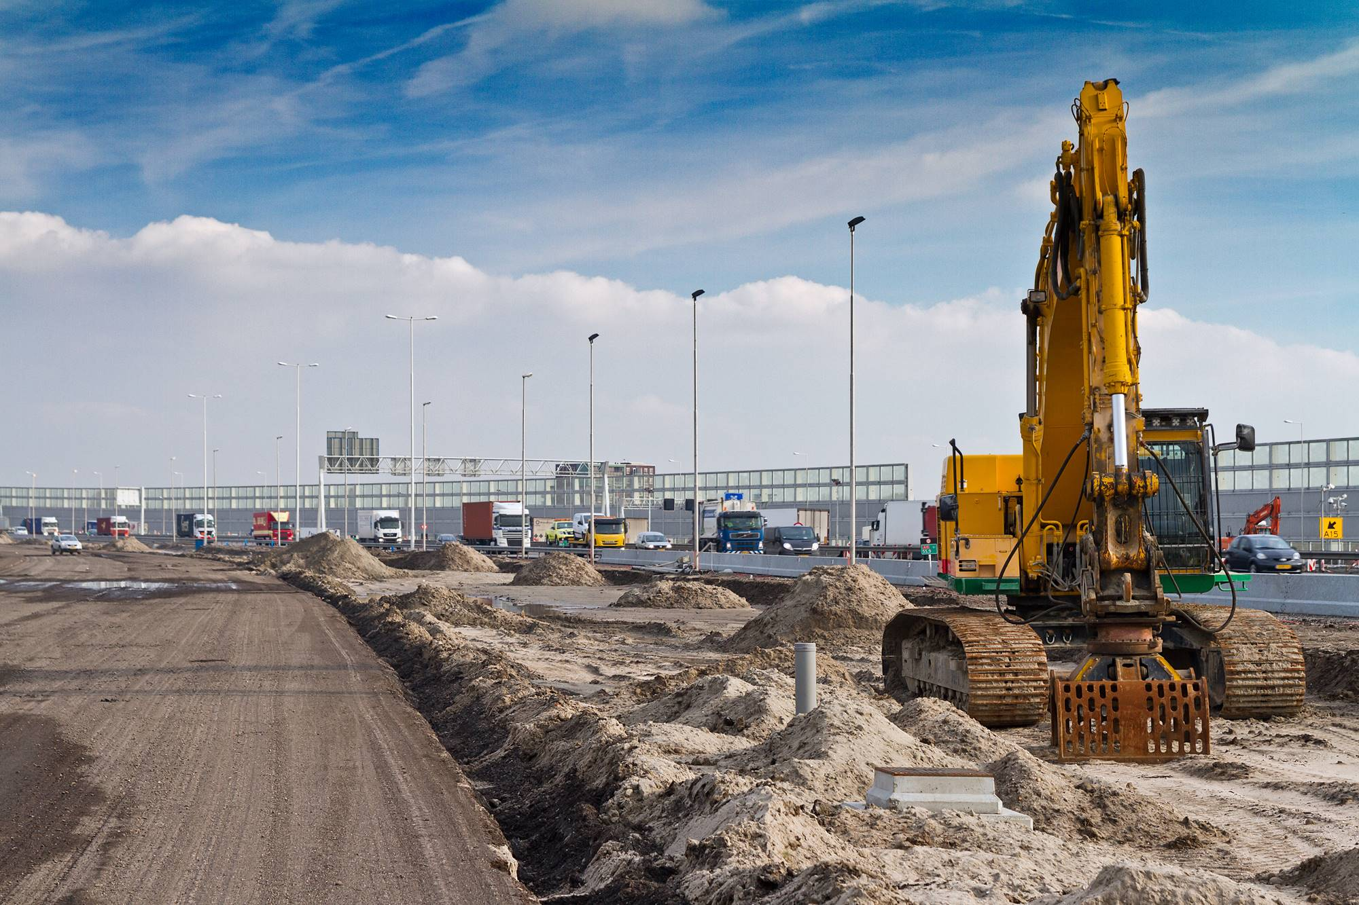
Public Infrastructure Projects – None

Slide 9
Unaudited Financial Statements

Slide 11
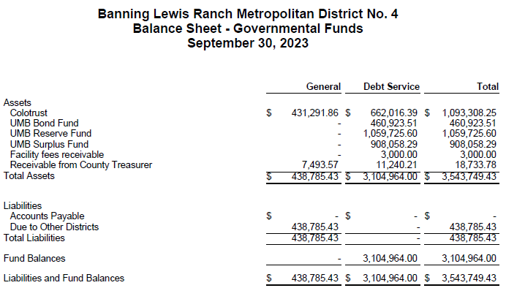

Slide 12
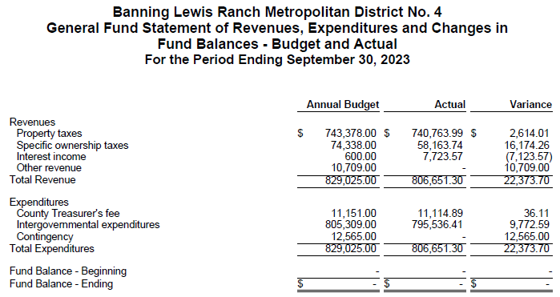

Slide 13
